Slide 1
Unsupervised learning with Clustering Techniques
Cincinnati Machine Learning Meetup
Sep 19th 2019
Srini Anand, MS
Illumination Works, LLC

Slide 2
Agenda
Measur-ing Success
An example
What is it and Why needed?
Approaches & Algorithms
Interpr-eting Results

Slide 3
What is Clustering
What & Why
Grouping like-objects together
There is no one definition of a cluster
Techniques are focused on enhancing similarity and separating dissimilar objects
One Aspect of Machine Learning
Regression Analysis
Regression
Estimation of a continuous variable
Classification
Estimation of a discrete variable
Clustering
Grouping like-objects together
Statistical processes for estimating the relationship among variables

Slide 4
Why do we need clustering?
What & Why
Gender
Height
Marketing - Customer/visitor segmentation
Text Analysis - Group similar documents
Insurance – Similar patients/doctors/drivers
Climate – Atmospheric patterns
Land Use
Financial Institutions – Fraud analytics
Travel distance
Programming Experience
Business Domain
Ethnicity
Experience with ML
Age range

Slide 5
Features of clustering algorithms
What & Why
Outcome
A good clustering method will produce high quality clusters
High intra-group similarity: cohesive within clusters
Low inter-group similarity: distinctive between clusters
Features
Discover clusters with arbitrary shape and/or size
Ability to deal with different types of attributes – numerical, categorical, text, or mixed
Ability to deal with noisy data
Incremental clustering and insensitivity to input order
High dimensionality

Slide 6
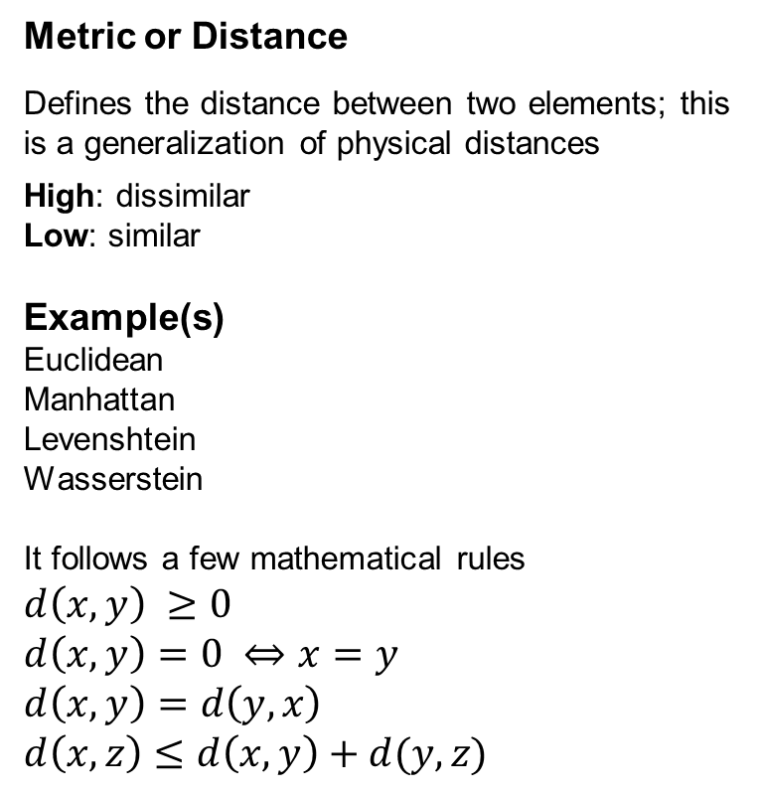
Terminology and Techniques
Metric or Distance
Defines the distance between two elements; this is a generalization of physical distances
High: dissimilar
Low: similar
Example(s)
Euclidean
Manhattan
Levenshtein
Wasserstein
It follows a few mathematical rules
$$d\left(x, y\right) ≥0$$
$$d\left(x, y\right)=0 ⇔x=y$$
$$d\left(x, y\right)=d\left(y, x\right)$$
$$d\left(x, z\right)≤d\left(x, y\right)+d(y, z)$$
Cohesion (aka Similarity)
A function that describes how related the data elements are to one another.
Low : dissimilar
High: similar
Example
Cosine similarity
Approach & Algos
Scaling and Transformation
Scaling is often required, especially when features have different scales
Note: Not all numerical measures should be scaled.
For example, Latitude and Longitude
Transformation can help algorithms by reducing noisy data – log transformation, PCA, Box-Cox etc.

Slide 7
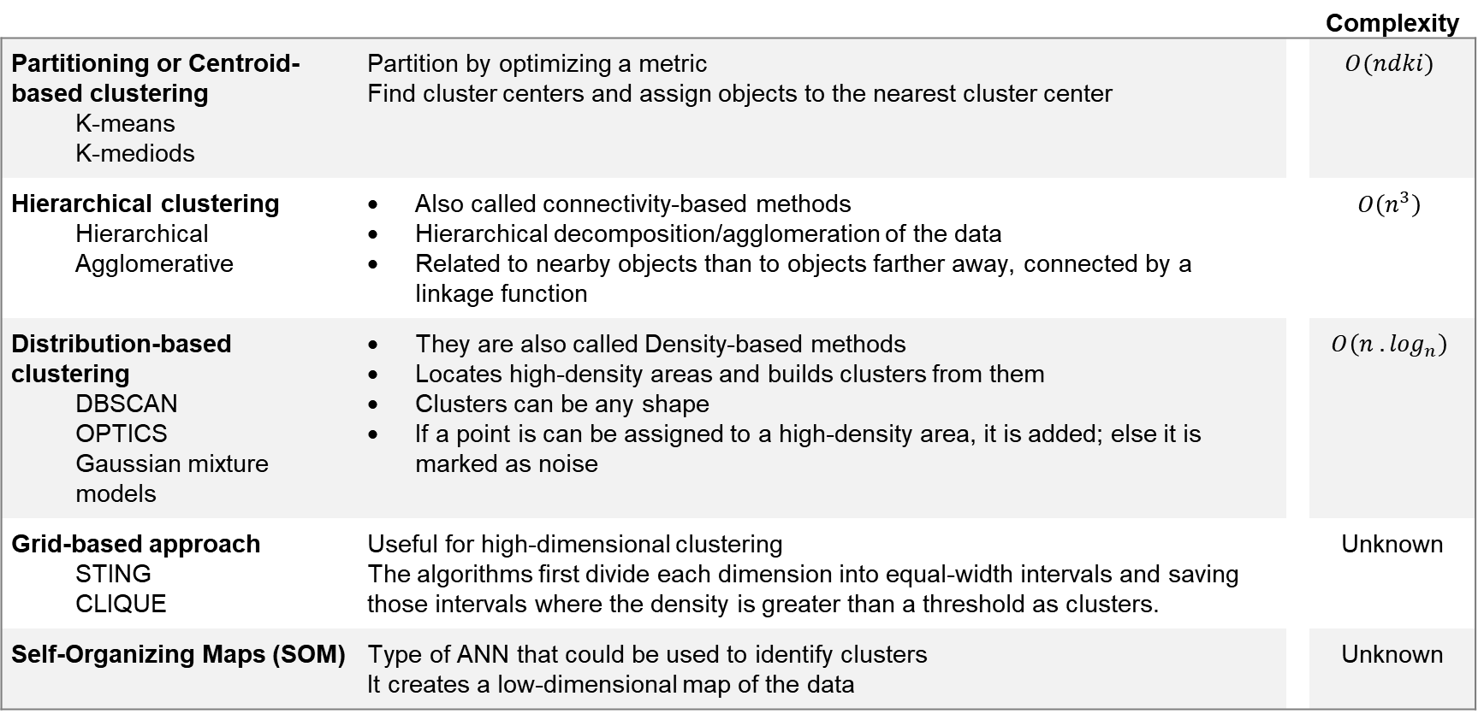
Approaches to clustering
 |  |  | Complexity
Partitioning or Centroid-based clustering K-means K-mediods | Partition by optimizing a metric Find cluster centers and assign objects to the nearest cluster center |  | $$O(ndki)$$
Hierarchical clustering Hierarchical Agglomerative | Also called connectivity-based methods Hierarchical decomposition/agglomeration of the data Related to nearby objects than to objects farther away, connected by a linkage function |  | $$O\left(n^{3}\right)$$
Distribution-based clustering DBSCAN OPTICS Gaussian mixture models | They are also called Density-based methods Locates high-density areas and builds clusters from them Clusters can be any shape If a point is can be assigned to a high-density area, it is added; else it is marked as noise |  | $$O\left(n . \log_{n}\right)$$
Grid-based approach STING CLIQUE | Useful for high-dimensional clustering The algorithms first divide each dimension into equal-width intervals and saving those intervals where the density is greater than a threshold as clusters. |  | Unknown
Self-Organizing Maps (SOM) | Type of ANN that could be used to identify clusters It creates a low-dimensional map of the data |  | Unknown
Approach & Algos
n: number of elements
d: number of features
k: number of clusters
i: number of iterations

Slide 8
Scalability and Use cases
 |  | Scalability | Use case | Metric
Partitioning or Centroid-based clustering K-means K-mediods |  | Very large datasets | General-purpose, even cluster size, flat geometry, not too many clusters | Distance between points (Euclidean distance only)
Hierarchical clustering Hierarchical Agglomerative |  | Large samples and clusters | Many clusters, possibly connectivity constraints | Any pairwise distance
Distribution-based clustering
DBSCAN OPTICS |  | Very large samples Medium # of clusters | Non-flat geometry, uneven cluster sizes, variable cluster density | Distances between points
Gaussian Models |  | Not scalable | Flat geometry, good for density estimation | Mahalanobis distances to centers
Grid-based approach STING CLIQUE |  | Very scalable
Self Organizing Maps (SOM) |  | Unknown | Unknown | Unknown
Approach & Algos

Slide 9
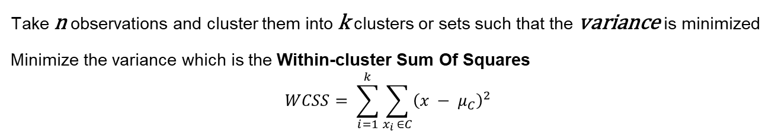
k-means clustering
Take n observations and cluster them into k clusters or sets such that the variance is minimized
Minimize the variance which is the Within-cluster Sum Of Squares
$$WCSS= \sum_{i=1}^{k}{\sum_{x_{i }∈C}{{\left(x − μ_{C}\right)}^{2}}}$$
Approach & Algos
Steps
Choose k random points as the mean (or center) of the clusters
Assign remaining points to the closest center; determine closest by using Euclidean distance metric
Update the centers with the new mean
If cluster assignment has not changed since the previous iteration, stop
Pros
One of the simplest algorithms to implement.
Relatively fast algorithm
Center of each cluster can define cluster characteristics
Cons
Does not guarantee convergence to a global minima
Requires user to pre-determine the number of clusters beforehand
Works well with clusters of similar sizes
The basic premise is that clusters are spherical and separable; not always true

Slide 10
Agglomerative Hierarchy Clustering
It uses a distance metric and a linkage criteria to group individual points (or sub-clusters) together. Two clusters separated by the shortest distance are combined
Steps
Each point is a cluster initially
Find another similar cluster and group together
Repeat (ii) until you have a good set of clusters or 1 cluster
Visualize the clustering activity by a dendogram diagram
Linkage criteria
Determines from where we measure the distance metric
Single-linkage – measure from two most similar (minimum distance) parts of the cluster
Complete-linkage – measure from two most dissimilar (maximum distance) parts of the cluster
Average-linkage – measure from the center of the clusters
Approach & Algos
Pros
Relatively easy to understand
Any valid distance metric can be used
Data elements are not used, just the distance matrix
Cons
Doesn’t work well with missing data and mixed mode data
Best with small and medium sized datasets
Sensitive to order of data and starting points

Slide 11
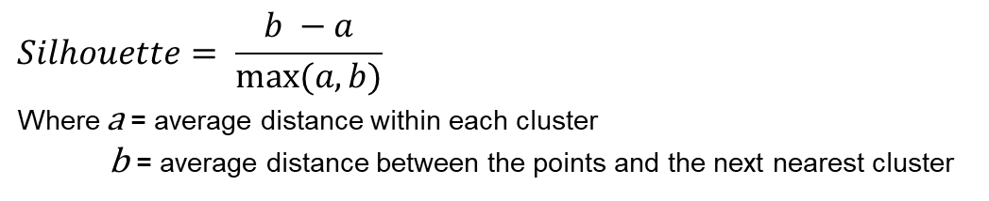
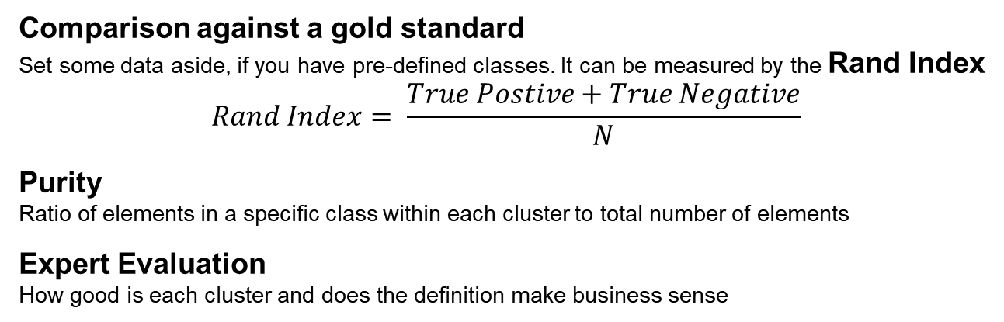
Measuring success
Based on the data
Dunn index
Ratio between the minimal inter-cluster distance to maximal intra-cluster distance
Silhouette score
Describes how similar elements in a cluster are compared to other clusters
$$Silhouette= \frac{b −a}{max⁡(a, b)}$$
Where a = average distance within each cluster
b = average distance between the points and the next nearest cluster
-1 | - | +1
Worst | to | Best
Measures
Other evaluation
Comparison against a gold standard
Set some data aside, if you have pre-defined classes. It can be measured by the Rand Index
$$Rand Index= \frac{True Postive+True Negative}{N}$$
Purity
Ratio of elements in a specific class within each cluster to total number of elements
Expert Evaluation
How good is each cluster and does the definition make business sense

Slide 12
Interpreting the outcome
How distinguishable is one cluster from the others?
How similar are elements in each cluster?
What are the shared characteristics of data elements belonging to one cluster?
What characteristics differentiate them with other clusters?
Look at the center/mean value of a k-means run!
Analyze the Proportion of a category in the cluster vs. its proportion in the whole sample
Use Feature Selection algorithms to understand the importance of variables – for example, Decision Trees
Interpreting

Slide 13
An Example
Find clusters within a pack of Playing cards
Color | Black |  | Red
Suite | Clubs ♣ | Spades ♠ | Diamonds ♦ | Hearts ♥
Face Value | A 2-9 J, Q, K | A 2-9 J, Q, K | A 2-9 J, Q, K | A 2-9 J, Q, K
 | Color | Suite | Face Value
0 | Black | Clubs | A
1 | Black | Clubs | 2
2 | Black | Clubs | 3
…
25 | Black | Spades | K
26 | Red | Diamonds | A
…
51 | Red | Hearts | K
Programmatic representation
Example

Slide 14
Data preparation
Numerical Values
Scaled
Scaled values
Categorical Values
One hot encoding
Numerical representation
 | Color | Suite | Face Value |  | Suit |  |  |  |  | Color |  |  | Face Value
 |  |  |  |  | Clubs | Spades | Diamonds | Hearts |  | Black | Red |  | A | 2 | 3 | … | Q | K
0 | Black | Clubs | A |  | 1 | 0 | 0 | 0 |  | 1 | 0 |  | 1 | 0 | 0 | … | 0 | 0
1 | Black | Clubs | 2 |  | 1 | 0 | 0 | 0 |  | 1 | 0 |  | 0 | 1 | 0 | … | 0 | 0
2 | Black | Clubs | 3 |  | 1 | 0 | 0 | 0 |  | 1 | 0 |  | 0 | 0 | 1 | … | 0 | 0
… | … | … | … |  | … | … | … | … |  | … | … |  | … | … | … | … | … | …
25 | Black | Spades | K |  | 0 | 1 | 0 | 0 |  | 1 | 0 |  | 0 | 0 | 0 | … | 0 | 1
26 | Red | Diamonds | A |  | 0 | 0 | 1 | 0 |  | 0 | 1 |  | 1 | 0 | 0 | … | 0 | 0
… | … | … | … |  | … | … | … | … |  | … | … |  | … | … | … | … | … | …
51 | Red | Hearts | K |  | 0 | 0 | 0 | 1 |  | 0 | 1 |  | 0 | 0 | 0 | … | 0 | 1
Total Features - 19 |  |  |  |  | 4 |  |  |  |  | 2 |  |  | 13
Example

Slide 15
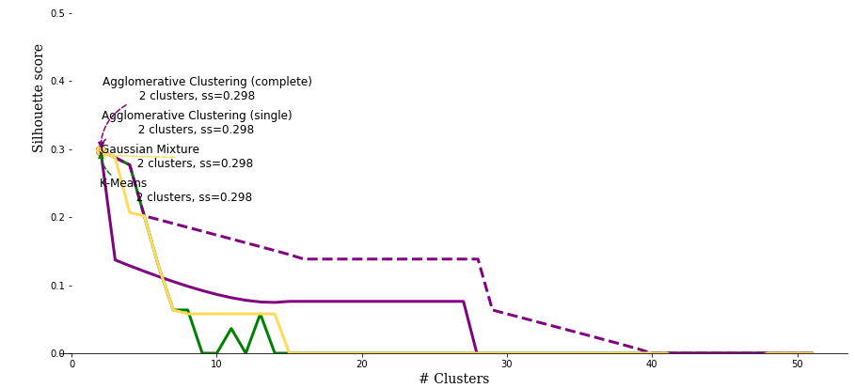
Algorithms and Results
Resulting Cluster composition
 | Black |  | Red
Cluster | Clubs | Spades | Diamonds | Hearts
0 |  |  | 13 | 13
1 | 13 | 13
K-Means
Agglomerative Clustering (single)
Agglomerative Clustering (complete)
Gaussian Mixture
Example

Slide 16
Improving the Results PCA-transformed data
 | Suit |  |  |  |  | Color |  |  | Face Value
 | Clubs | Spades | Diamonds | Hearts |  | Black | Red |  | A | 2 | 3 | … | Q | K
0 | 1 |  |  |  |  | 1 |  |  | 1
1 | 1 |  |  |  |  | 1 |  |  |  | 1
2 | 1 |  |  |  |  | 1 |  |  |  |  | 1
25 |  | 1 |  |  |  | 1 |  |  |  |  |  |  |  | 1
26 |  |  | 1 |  |  |  | 1 |  | 1
51 |  |  |  | 1 |  |  | 1 |  |  |  |  |  |  | 1
19 features – Highly sparse
PCA Transformation
95% of variance
 | 0 | 1 | 2 | 3 | 4 | 5 | 6 | 7 | 8 | 9 | 10 | 11 | 12 | 13
0 | -0.99 | 0.00 | 1.40 | 0.10 | 1.32 | -0.19 | -0.44 | -0.69 | -0.09 | -0.43 | -0.31 | 3.00 | 0.04 | 0.19
1 | -0.99 | 0.00 | 1.40 | -1.20 | 1.46 | 0.16 | 0.10 | -1.93 | 0.67 | -0.81 | 0.32 | -1.42 | 1.10 | -0.10
2 | -0.99 | 0.00 | 1.40 | -0.92 | -1.32 | -0.96 | 0.15 | 0.01 | 0.02 | -1.04 | 0.20 | -0.02 | -0.65 | 2.57
25 | -0.99 | 0.00 | -1.40 | -0.16 | -0.32 | -0.49 | 0.63 | 0.22 | 1.16 | -0.38 | 1.94 | 0.25 | -1.62 | -1.62
26 | 0.99 | -1.40 | 0.00 | 0.10 | 1.32 | -0.19 | -0.44 | -0.69 | -0.09 | -0.43 | -0.31 | 3.00 | 0.04 | 0.19
51 | 0.99 | 1.40 | 0.00 | -0.16 | -0.32 | -0.49 | 0.63 | 0.22 | 1.16 | -0.38 | 1.94 | 0.25 | -1.62 | -1.62
14 features – fully dense
Example

Slide 17
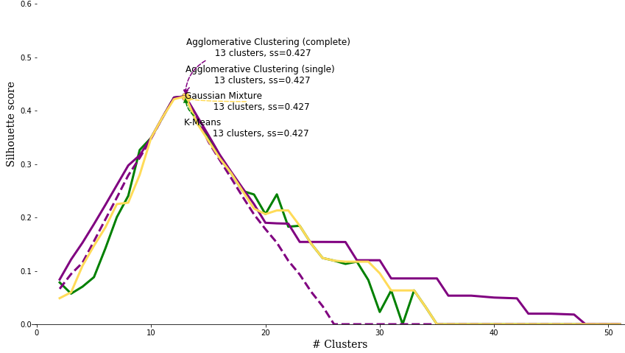
Improving the Results PCA-transformed data
Resulting Cluster composition
 | Black |  | Red
Cluster | Clubs | Spades | Diamonds | Hearts
0 | 1 | 1 | 1 | 1
1 | 1 | 1 | 1 | 1
2 | 1 | 1 | 1 | 1
3 | 1 | 1 | 1 | 1
4 | 1 | 1 | 1 | 1
5 | 1 | 1 | 1 | 1
6 | 1 | 1 | 1 | 1
7 | 1 | 1 | 1 | 1
8 | 1 | 1 | 1 | 1
9 | 1 | 1 | 1 | 1
10 | 1 | 1 | 1 | 1
11 | 1 | 1 | 1 | 1
12 | 1 | 1 | 1 | 1
13 | 1 | 1 | 1 | 1
K-Means
Agglomerative Clustering (single)
Agglomerative Clustering (complete)
Gaussian Mixture
Example

Slide 18
Evaluating the results
0
1 | 2
 | 0 | 1
Silhouette Score
-1
0
+1
Distance matrix for un-transformed data
0
1 | 5
2 | 5 | 5
3 | 5 | 5 | 5
4 | 5 | 4 | 5 | 5
5 | 5 | 5 | 5 | 5 | 5
6 | 5 | 5 | 5 | 5 | 5 | 5
7 | 5 | 5 | 5 | 5 | 5 | 5 | 5
8 | 5 | 5 | 5 | 5 | 5 | 5 | 5 | 5
9 | 5 | 5 | 5 | 5 | 5 | 5 | 5 | 5 | 5
10 | 5 | 5 | 5 | 4 | 4 | 5 | 5 | 5 | 5 | 5
11 | 5 | 5 | 5 | 4 | 4 | 5 | 5 | 5 | 5 | 5 | 5
12 | 5 | 5 | 5 | 4 | 4 | 5 | 5 | 5 | 5 | 5 | 5 | 5
 | 0 | 1 | 2 | 3 | 4 | 5 | 6 | 7 | 8 | 9 | 10 | 11 | 12
Raw Data
Silhouette Score: 0.298
Clusters: 2
Based on: Card Color
PCA Transformed Data
Silhouette Score: 0.427
Clusters: 13
Based on: Face Value
In both datasets, the Silhouette score is relatively low
However, the results are intuitive
Example
The Distance matrixes shows us that the distance from any one cluster to another is about the same
Distance matrix for PCA Transformed data

Slide 19
Conclusion
Analyze and UNDERSTAND your data
Types of data
Sparsity
Distribution
Special characteristics
Start with a SIMPLE ALGORITHM
Which approach and algorithm will be both sufficient and capable
After identifying the clusters, SIMPLIFY your EXPLANATION to users
Identify the characteristics of your clusters
Determine which features drove the clusters to be determined

Slide 20
Bibliography
Sklearn tutorial on clustering*
Schubert, Erich 2017 Knowledge Discovery in Databases*
Cluster Analysis, Wikipedia*
Yeung, Ka Yee et al April 2001. Model-Based Clustering and Data Transformations for Gene Expression Data, Technical Report UW-CSE-2001-04-01
Deza, M. M. and Deza, E. 2009 Encyclopedia of Distances. 3rd. Springer, isbn: 9783662443415
Santni, Marina 2016 Advantages & Disadvantages of k--‐Means and Hierarchical clustering (Unsupervised Learning)
Lisboa, Paulo JG et al 2010 Finding reproducible cluster partitions for the k-means algorithm BMC Bioinformatics 2013, 14(Suppl 1):S8
Ester, Martin et al 1996. A Density-Based Algorithm for Discovering Clusters in Large Spatial Databases with Noise. KDD-96 Proceedings
Jost Schatzmann 2003 Using Self-Organizing Maps to Visualize Clusters and Trends in Multidimensional Datasets. Imperial College, London
* Recommend highly

